Slide 1
CSE 301
Combinatorial Optimization
Lecture 2
Recurrence

Slide 2
Today’s Topic
Recurrence
  Substitution Method
  Recursive Method
  Master Method
  Akra-bazzi method

Slide 3
Recurrence Relations
A recurrence relation is the recursive part of a recursive definition of either a number sequence or integer function.

Slide 4
Recursively Defined Sequences
Fibonacci sequence:
  {f_{n} } = 0,1,1,2,3,5,8,13,21,34,55,…
  Recursive definition for {f_{n} }:
  INITIALIZE: f₀ = 0, f₁ = 1
  RECURSE: f_{n} = f_{n-1}+f_{n-2} for n > 1.
  The recurrence relation is the recursive part
  f_{n} = f_{n-1}+f_{n-2}.Thus a recurrence relation for a sequence consists of an equation that expresses each term in terms of lower terms.

Slide 5
Substitution method
The most general method:
Guess the form of the solution.
Verify by induction.
Solve for constants.
Example: T(n) = 2T(n/2) + n
[Assume that T(1) = Θ(1).]
Guess O(n lg n) .
Assume that T(k) ≤ ck lgk for k < n .
Prove T(n) ≤ cn lg n by induction.

Slide 6
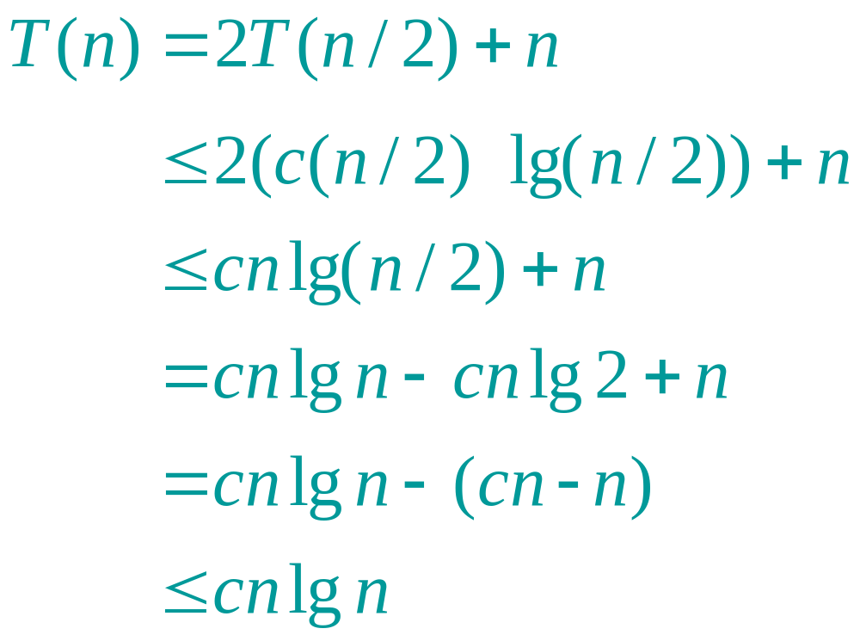
Example of substitution
desired – residual
desired
whenever cn – n ≥ 0, for example, if c ≥ 2 and n ≥ 1.
residual

Slide 7
Evaluate recursive equation using Recursion Tree
Evaluate: T(n) = T(n/2) + T(n/2) + n
  Work copy: T(k) = T(k/2) + T(k/2) + k
  For k=n/2, T(n/2) = T(n/4) + T(n/4) + (n/2)
[size|cost]

Slide 8
Recursion-tree method
A recursion tree models the costs (time) of a recursive execution of an algorithm.
The recursion tree method is good for generating guesses for the substitution method.
The recursion-tree method can be unreliable.
The recursion-tree method promotes intuition, however.

Slide 9
Recursion Tree e.g.
To evaluate the total cost of the recursion tree
  sum all the non-recursive costs of all nodes
  = Sum (rowSum(cost of all nodes at the same depth))
Determine the maximum depth of the recursion tree:
  For our example, at tree depth d
  the size parameter is n/(2^{d})
  the size parameter converging to base case, i.e. case 1
  such that, n/(2^{d}) = 1,
  d = lg(n)
  The rowSum for each row is n
Therefore, the total cost, T(n) = n lg(n)

Slide 10
Example of recursion tree
Solve T(n) = T(n/4) + T(n/2) + n²:

Slide 11
Example of recursion tree
Solve T(n) = T(n/4) + T(n/2) + n²:
T(n)

Slide 12
Example of recursion tree
Solve T(n) = T(n/4) + T(n/2) + n²:
n²
T(n/4)
T(n/2)

Slide 13
Example of recursion tree
Solve T(n) = T(n/4) + T(n/2) + n²:
n²
(n/4)²
(n/2)²
T(n/16)
T(n/8)
T(n/8)
T(n/4)

Slide 14
Example of recursion tree
Solve T(n) = T(n/4) + T(n/2) + n²:
n²
(n/4)²
(n/2)²
(n/16)²
(n/8)²
(n/8)²
(n/4)²
…
Θ(1)

Slide 15

Example of recursion tree
Solve T(n) = T(n/4) + T(n/2) + n²:
n²
(n/4)²
(n/2)²
(n/16)²
(n/8)²
(n/8)²
(n/4)²
…
Θ(1)

Slide 16
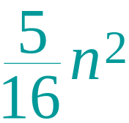
Example of recursion tree
Solve T(n) = T(n/4) + T(n/2) + n²:
n²
(n/4)²
(n/2)²
(n/16)²
(n/8)²
(n/8)²
(n/4)²
…
Θ(1)

Slide 17
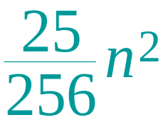
Example of recursion tree
Solve T(n) = T(n/4) + T(n/2) + n²:
n²
(n/4)²
(n/2)²
(n/16)²
(n/8)²
(n/8)²
(n/4)²
…
…
Θ(1)

Slide 18
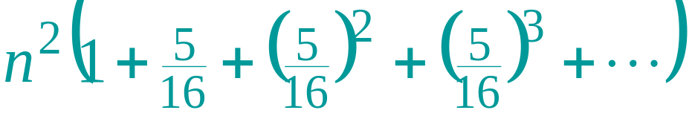
Example of recursion tree
Solve T(n) = T(n/4) + T(n/2) + n²:
n²
(n/4)²
(n/2)²
(n/16)²
(n/8)²
(n/8)²
(n/4)²
…
…
Θ(1)
Total =
= Θ(n²)
geometric series

Slide 19
The divide-and-conquer design paradigm
Divide the problem (instance) into subproblems.
Conquer the subproblems by solving them recursively.
Combine subproblem solutions.

Slide 20
Example: merge sort
Divide: Trivial.
Conquer: Recursively sort 2 subarrays.
Combine: Linear-time merge.
T(n) = 2 T(n/2) + O(n)
# subproblems
work dividing and combining
subproblem size

Slide 21
The master method
The master method applies to recurrences of the form
T(n) = a T(n/b) + f (n) ,
where a ≥ 1, b > 1, and f is asymptotically positive.

Slide 22
Three common cases
Compare f (n) with n^{logba}:
f (n) = O(n^{logba – ε}) for some constant ε > 0.
  f (n) grows polynomially slower than n^{logba} (by an n^{ε} factor).
Solution: T(n) = Θ(n^{logba}) .
f (n) = Θ(n^{logba}).
  f (n) and n^{logba} grow at similar rates.
  Solution: T(n) = Θ(n^{logba} lg n) .

Slide 23
Three common cases (cont.)
Compare f (n) with n^{logba}:
f (n) = Ω(n^{logba + ε}) for some constant ε > 0.
  f (n) grows polynomially faster than n^{logba} (by an n^{ε} factor),
and f (n) satisfies the regularity condition that a f (n/b) ≤ c f (n) for some constant c < 1.
Solution: T(n) = Θ( f (n) ) .

Slide 24

Examples
Ex. T(n) = 4T(n/2) + n
a = 4, b = 2 ⇒ n^{logba} = n²; f (n) = n.
CASE 1: f (n) = O(n^{2 – ε}) for ε = 1.
∴ T(n) = Θ(n²).
Ex. T(n) = 4T(n/2) + n²
a = 4, b = 2 ⇒ n^{logba} = n²; f (n) = n².
CASE 2: f (n) = Θ(n²).
∴ T(n) = Θ(n²lg n).

Slide 25
Examples
Ex. T(n) = 4T(n/2) + n³
a = 4, b = 2 ⇒ n^{logba} = n²; f (n) = n³.
CASE 3: f (n) = Ω(n^{2 + ε}) for ε = 1
and 4(cn/2)³ ≤ cn³ (reg. cond.) for c = 1/2.
∴ T(n) = Θ(n³).
Ex. T(n) = 4T(n/2) + n²/lg n
a = 4, b = 2 ⇒ n^{logba} = n²; f (n) = n²/lg n.
Master method does not apply. In particular, for every constant ε > 0, we have n^{ε} = ω(lg n).

Slide 26
General method (Akra-Bazzi)
The Master method is fairly powerful and results in a closed form solution for divide-and-conquer recurrences with a special form.
Akra and Bazzi discovered a far more general solution to divide-and-conquer recurrences.

Slide 27
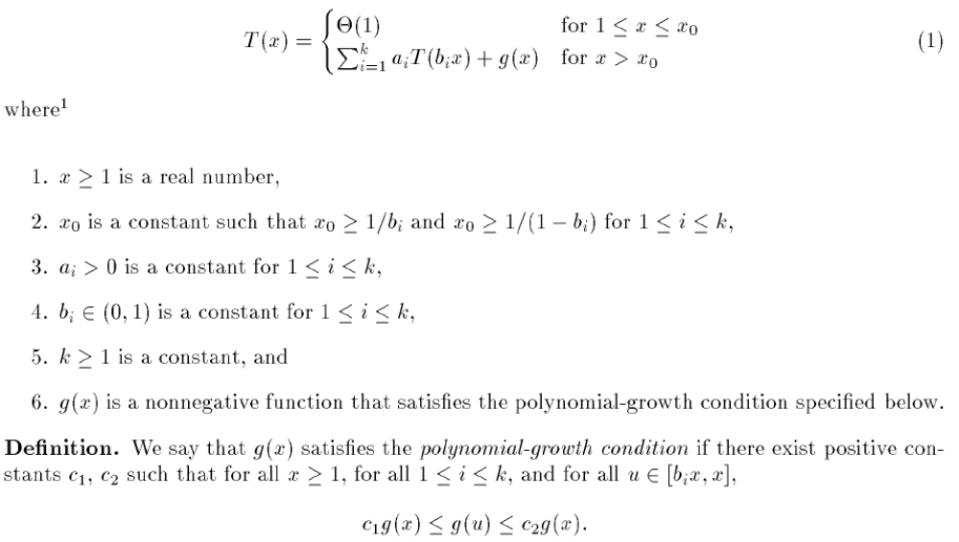
The Akra-Bazzi Method

Slide 28
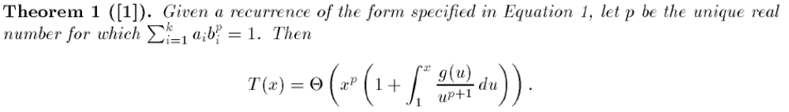
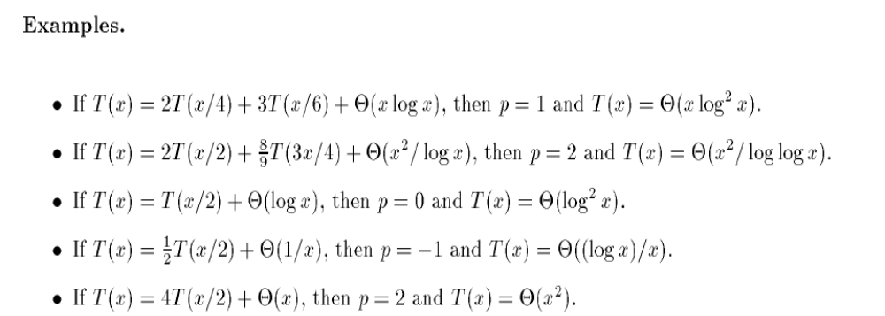
The Akra-Bazzi Solution

Slide 29
Idea of master theorem
Recursion tree:
f (n)
f (n)
a
f (n/b)
f (n/b)
…
f (n/b)
a f (n/b)
n=bh
h = log_{b}n
a
f (n/b²)
f (n/b²)
…
f (n/b²)
a² f (n/b²)
…
…
#leaves = a^{h}
= a^{logbn}
= n^{logba}
n^{logba}Τ (1)
Τ (1)

Slide 30
Idea of master theorem
Recursion tree:
f (n)
f (n)
a
f (n/b)
f (n/b)
…
f (n/b)
a f (n/b)
a
h = log_{b}n
f (n/b²)
f (n/b²)
…
f (n/b²)
a² f (n/b²)
…
…
CASE 1: The weight increases geometrically from the root to the leaves. The leaves hold a constant fraction of the total weight.
n^{logba}Τ (1)
Τ (1)
Θ(n^{logba})

Slide 31
Idea of master theorem
Recursion tree:
f (n)
f (n)
a
f (n/b)
f (n/b)
…
f (n/b)
a f (n/b)
a
h = log_{b}n
f (n/b²)
f (n/b²)
…
f (n/b²)
a² f (n/b²)
…
…
CASE 2: (k = 0) The weight is approximately the same on each of the log_{b}n levels.
n^{logba}Τ (1)
Τ (1)
Θ(n^{logba}lg n)

Slide 32
Idea of master theorem
Recursion tree:
f (n)
f (n)
a
f (n/b)
f (n/b)
…
f (n/b)
a f (n/b)
a
h = log_{b}n
f (n/b²)
f (n/b²)
…
f (n/b²)
a² f (n/b²)
…
…
CASE 3: The weight decreases geometrically from the root to the leaves. The root holds a constant fraction of the total weight.
n^{logba}Τ (1)
Τ (1)
Θ( f (n))

